Slide 1


American Express Makeathon 2024
Automated Financial Planning

Slide 2

👨‍👦‍👦Team name and member details
Team Name : SparkHacker
Team Member :
Member 1: SHAINI MOHANTY
Member 2: SMRUTEE BEHERA
Member 3: HIYA CHATTERJEE
Theme Name : AUTOMATED FINANCIAL PLANNING

Slide 3
🚩 Problem statement
Automated Financial Planning Overview Automated financial planning aims to simplify the process of financial planning and wealth management for individuals by using generative AI technology. This tool should analyze user’s financial data, identify their financial goals and priorities, and recommend personalized strategies to achieve them. It provides features such as budget tracking, goal setting, investment portfolio management, and retirement planning, helping users make informed financial decisions and achieve long-term financial success.
Tasks
Design and develop machine learning algorithms to analyze users' financial data and identify their financial goals.
Implement features for budget tracking, goal setting, investment portfolio management, and retirement planning.
Integrate user-friendly interfaces for users to input financial data, set goals, and monitor progress.
Ensure security and privacy of user’s financial information through robust authentication and encryption mechanisms.

Slide 4
💡 Solution
EVER NOTICED HOW DIFFICULT IT IS FOR A BEGINNER IN THE FIELD OF FINANCIAL PLANNING AND INDIVIDUAL FINANCIAL GROWTH TO NAVIGATE THROUGH A SEA OF WEBSITES TO FIND OUT THEY HAVE WASTED A TON OF TIME ONLY DECIDING WHICH PLATFORM IS BEST FOR THEM WE SOLVED ALL THESE ISSUES….
WE provide solution with automatic aggregation and reconciliation of all transactions for an individual, providing a 360-degree view of their financial health at any time. We provide:
Clear goals: Having one Financial Partner helps in setting up clear Investment goals.
GenAI recommendation: We use AI algorithms to recommend personalized strategies, credit cards and planners. Besides these we also provide a tons of budgeting tools to handle all kinds of expenses and investment portfolios.
Unbiased approach: A thorough portfolio review - with evaluation of strengths, weaknesses and specific recommendations is offered by us. The suggestions to clients are unbiased and as per the clients requirement.
Proper Asset Allocation: A financial partner like us that offers various products and services can help you with a proper asset allocation for short-term, long-term financial goals along with tax saving, Retirement planning and Insurance.
Continuous Tracking & Re-balancing: we continuously tracks users preferences and requirements to provide one platform solution for all wealth related requirements of an individual.

Slide 5
How it helps to solve the problem?
Reminders: Receive timely reminders for bill payments, savings targets, and investment opportunities, helping you stay organized and on track.
Budget Planner: Efficiently manage your finances by creating and monitoring budgets to achieve your goals.
Automated Saving: Simplify saving with automated transfers to savings accounts, making it easier to build your nest egg.
Investment Portfolio: Receive personalized investment suggestions tailored to your risk tolerance and financial objectives.
Hassle-Free AI Solutions: Our AI-driven system simplifies complex financial decisions, ensuring clarity and ease of use.
Educational Resources: Access a variety of educational materials in our feature article section to enhance your financial knowledge and make informed decisions.

Slide 6
Financial Calculators: Utilize our calculators to determine loan repayments, investment returns, and more, facilitating informed financial planning.
Best Credit Card Deals: Discover credit card options provided by American Express aligned with your spending habits and financial goals, ensuring optimal benefits.
Advice for Maximum Utilization: Receive personalized advice on how to maximize the benefits of your financial resources.
24 X 7 Chatbot Assistance: Access instant support at any time through our chatbot, ensuring continuous assistance whenever you need it.
Insurance Coverage: Explore insurance options to safeguard your assets and protect your financial well-being.
Personal and Business Finance Solutions: Whether it's personal or business finances, our tool provides tailored solutions to meet your needs.
Retirement Planning: Plan for retirement confidently, knowing your future is secure and well-managed.

Slide 7
What are the impact metrics that one can use to analyze the effect of the solution?
Risk- Management: AI algorithms can monitor investment portfolios, analyse market conditions, and automatically rebalance asset allocations to maintain desired risk-return profiles.
Personalization: Automated financial planning and budgeting tools leverage AI to help individuals manage their finances effectively. These tools can analyze spending patterns, provide budgeting recommendations, and offer personalized suggestions for optimizing financial health.
Scalability: Measure the ability of automated financial planning processes to handle increased transaction volumes and customer interactions without compromising performance.
Revenue Growth: Track any increases in revenue attributed to improved customer engagement, new product offerings, or increased customer retention
Adoption Rate: Track the adoption rate of automated financial planning tools among Amex customers to gauge their acceptance and effectiveness.

Slide 8







Frameworks/Technologies stacks to be used

Slide 9
Assumptions, constraints, and solution decision points (Reason behind choosing a technology)
1. Develop machine learning algorithms using TensorFlow to analyze users' financial data, identifying patterns and trends to understand their financial goals and recommend personalized strategies. Receive timely reminders for bill payments, savings targets, and investment opportunities, and update Calander helping user stay organized
2. Implement budget tracking, goal setting, investment portfolio management, and retirement planning dashboard features using web development technologies like HTML/CSS ,JavaScript , React for user interaction. We employ the robust combination of MySQL and MongoDB to maintain our user database in the backend.
3. Integrate user-friendly interfaces for seamless input of financial data, goal setting, and using Python for data analytics gives visual progress monitoring via plotting graphs, ensuring ease of use and accessibility for users.
4. Keeping in mind the AI algorithms have access to user data, data privacy, security and authentication need to be ensured by implementing robust authentication and end-to –end encryption mechanisms, leveraging cloud computing platforms like Azure for secure data storage and management.

Slide 10
How easily can your solution be implemented and how effective will it be?
1. User-Friendly Interface: Our solution offers a clear dashboard with all necessary information readily available. Users can easily navigate and understand their finances at a glance.
2. Continuous Support: With a 24/7 chatbot assistance and Financial calculators users can get instant support whenever they need it, ensuring they never feel stranded or confused while using the platform.
3. Security Assurance: All user data is end-to-end encrypted, guaranteeing privacy and protection against unauthorized access. Users can trust that their sensitive information remains secure.
4. Personalized Recommendations: Leveraging advanced AI, our solution provides personalized recommendations tailored to each user's financial goals and preferences, ensuring relevance and effectiveness in managing their finances.
5. Convenient Reminders and Notifications: Users receive timely reminders for bill payments and savings targets, helping them stay organized and on track with their financial responsibilities and goals.

Slide 11
Extent Of Scalability and usability:
To measure the extent of scalability and usability of automated financial planning :
1. Transaction Volume: Measure the system's ability to handle increasing transaction volumes without degradation in performance or accuracy. This can be done by tracking the number of transactions processed over time.
2. User Load: Evaluate how well the system handles a growing number of users simultaneously accessing the platform. This can be measured by monitoring server response times under varying user loads.
4. Usability Testing: Conduct usability tests to evaluate how easily users can navigate the automated financial planning platform. This can involve observing users as they interact with the system and collecting feedback on its ease of use.
5. Error Rates: Monitor the system's error rates under different usage scenarios to assess its scalability and usability. A high error rate may indicate scalability issues or usability challenges that need to be addressed.
6. Response Time: Measure the system's response time to user interactions, such as generating financial plans or providing recommendations. A slow response time may indicate scalability issues or usability challenges.

Slide 12
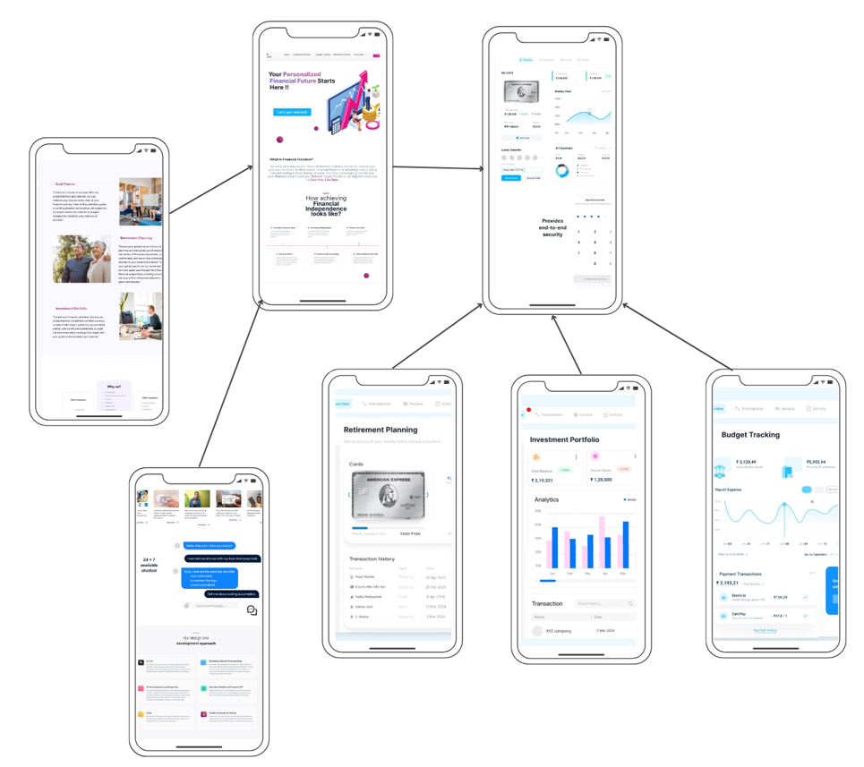
📊 Architecture diagram
For prototype Figma Link provided:
https://www.figma.com/file/K0jgYOHrIZyL9dUNT2wcUT/American-Express-Makeathon-2024?type=design&node-id=0-1&mode=design&t=w7QMuOI0HD68AANc-0
For detailed explanation Youtube Link is provided: https://www.youtube.com/watch?v=7XffKTU390o

Slide 13
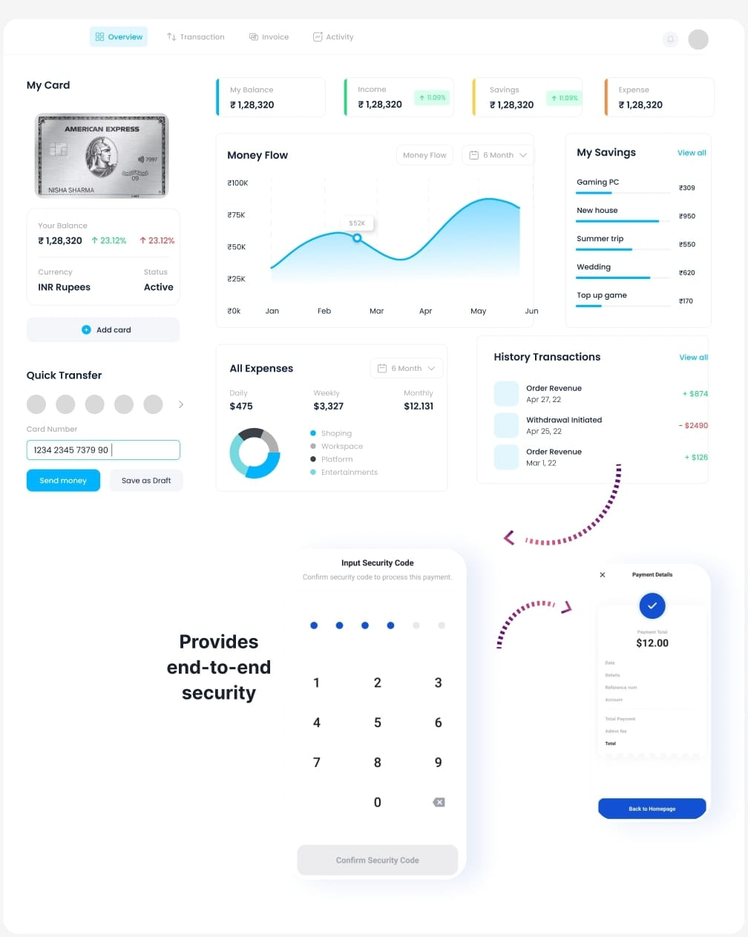
Dashboards with graphs that speaks

Slide 14
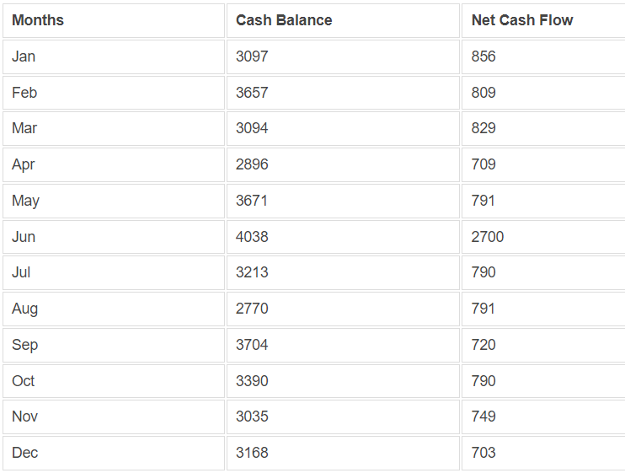
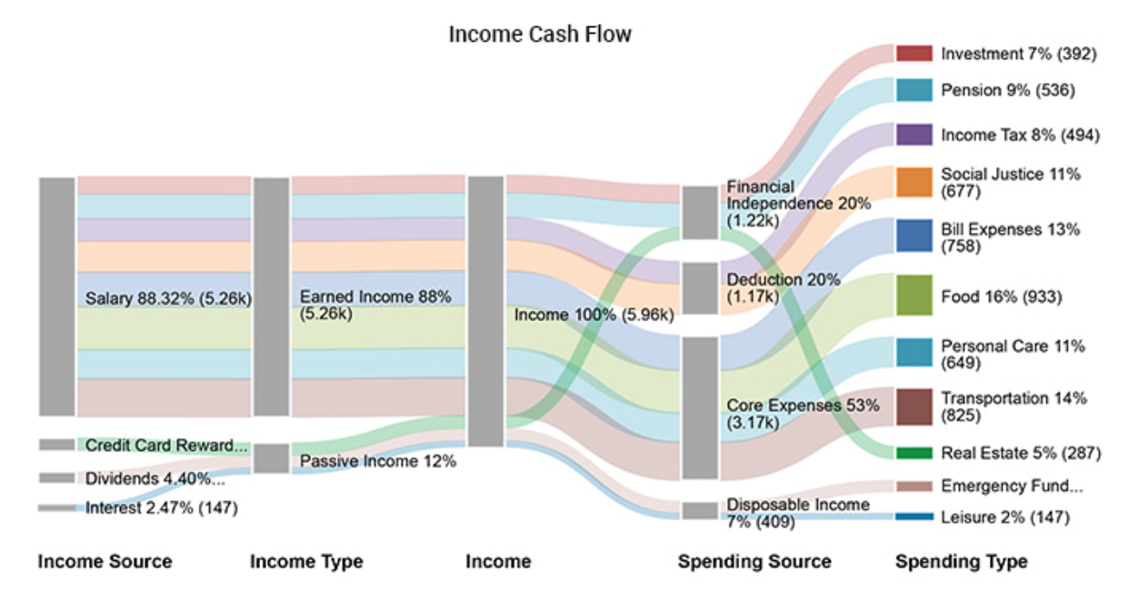
from boring datasheets to visually appealing cash flow graphs..

Slide 15
🎯 Impact / Novelty
Novelty of the work:
1. The platform has “GEMMA” integrated chatbots to guide users in every step of the financial journey and features articles, blogs, daily news, and expert reviews of the stocks.
2. Armed with the right cards from American Express, users get rewards and customized recommendations about the best-suited services for them.
3. You won’t really have to deal with converting currency and, armed with the right credit card, you won’t pay unnecessary foreign transaction fees.
4. Prioritizing security and privacy reassures American Express users that their financial data is protected, distinguishing the company as a trusted steward of sensitive information in the digital age.

Slide 16
🚀 Future Scope
Scope of modification
With further advancements in the field of AI, users get to use completely customized dashboards and recommendations as per their requirements.
Since the platform is adaptable to all kinds of changes, the services provided can be increased with the changing users’ preferences.

Slide 17
Business Relevance
To measure the extent of scalability and usability of automated financial planning :
Personalized Credit Card Recommendation System: Personalized credit card recommendations based on profile, financial goals and spending patterns. Travel a lot? No problem, use our cards that provide airfare and lounge benefits and much more!
Personalized Financial Insights: Receive personalized financial insights based on your Amex spending patterns. Understand your expenses better and make informed decisions to optimize your finances.
Efficient Expense Management: Streamline expense management for your business. Categorize expenses, track spending, and generate insightful reports to manage your budget effectively with our multi-featured dashboard.
Tailored Investment Opportunities: Receive personalized investment suggestions based on your financial data, including your American Express transactions. Grow your wealth with targeted investment opportunities aligned with your financial objectives.
Solutions for business and personal use: Keeping in mind with Amex schemes, we have different solutions and features designed for personal and business use so that businesses can leverage Amex’s various rewards and solutions.
Retirement Planning: Make retirement easy with Amex partnered travel deals, hospital and healthcare benefits and insurance options.
Financial Calculators: Financial education, Calculators with calculation transparency such that it is easier for user to manage and se goals all at one stop.
AI Chatbot: A chatbot that helps you find links and solutions without you having to search for them manually.

Slide 18
How we are optimizing it......
1. With instant expense tracking features and as a constant travel companion, our app powered by American express cards purchase protection helps users travel carefree.
2. Streamlining user portfolios and financial transactions with Ai powered graphs and stats.
3. Increasing user conversion rates with interactive UI/UX designs and understandable solutions without too much jargon.
4. Strengthened security measures: Implementing robust authentication and encryption mechanisms ensures the security and privacy of users' financial information, enhancing trust and confidence in American Express's services.

Slide 19

Thank You !

